Slide 1
边缘检测实现过程演示

Slide 2
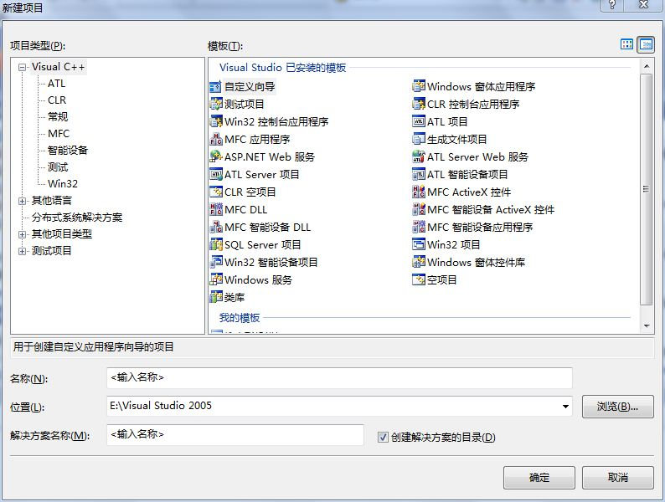
第一步：选择菜单栏上的“文件” → “新建” →“项目”命令，打开“新建项目”对话框，如图所示。

Slide 3
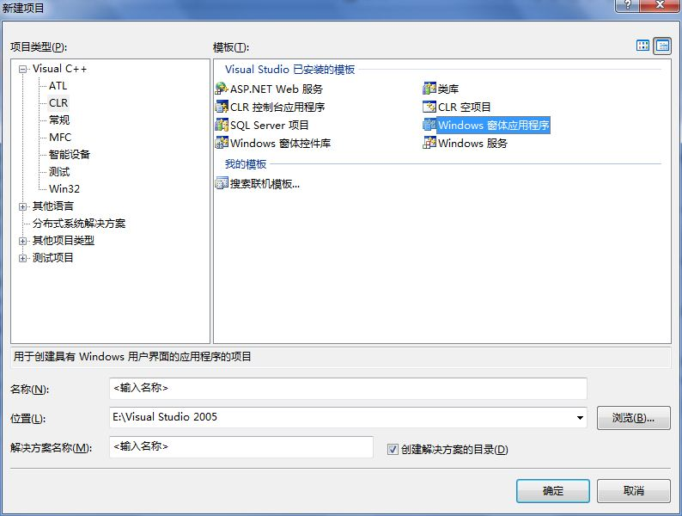
在左侧面板中选择“Visual C++”中的CLR子项，在右侧面板中选择“Windows窗体应用程序”。

Slide 4
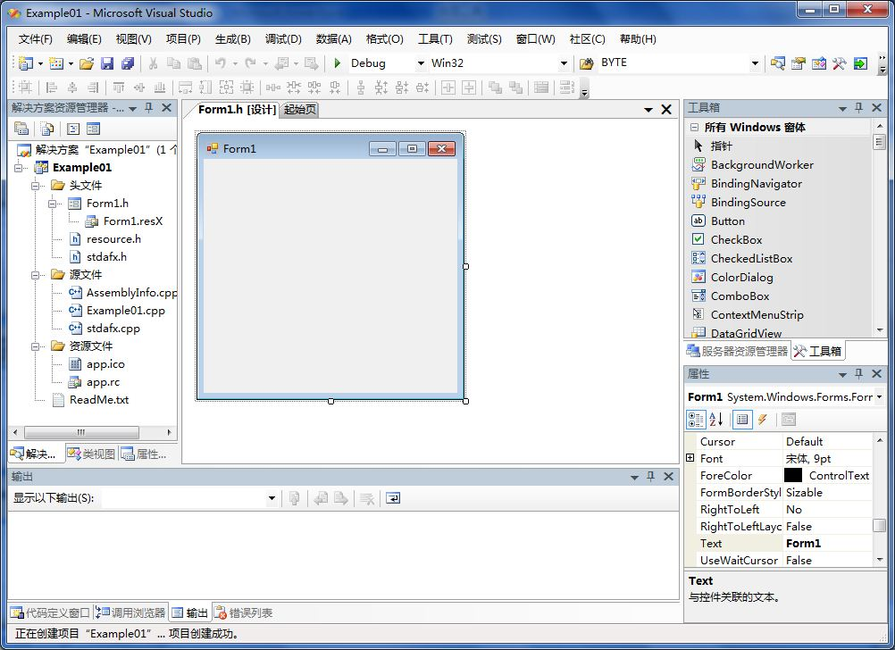
输入“名称”，“位置”和“解决方案名称”，单击“确定”按钮，便创建了一个新项目。

Slide 5
在工具箱里将控件MenuStrip, GroupBox, PictureBox, 分别拖入form1窗体中，并调整到合适的位置。
将所需命令或选项添加到控件MenuStrip中。
将控件PictureBox放入GroupBox中，如需要可设置PictureBox和GroupBox的属性。如将groupbox1的Text属性设置为“原图像”。
如图所示：

Slide 6
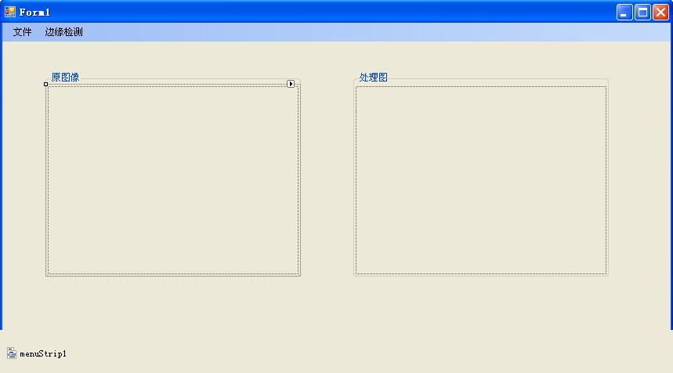

Slide 7
定义全局变量
把下列代码放到Form1.h中
public:
typedef unsigned char BYTE;
Bitmap^ original_bmap;
Bitmap^ processed_bmap;
int nWidth; //图像宽
int nHeight; //图像高
BYTE **oriImage; //原图灰度
BYTE **proImage; //处理后灰度

Slide 8
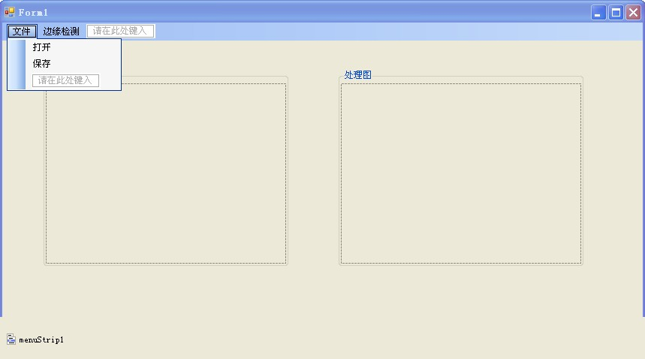
文件下拉菜单中有“打开”和“保存”

Slide 9
双击“打开”命令，添加如下代码
OpenFileDialog^ openFile1 = gcnew OpenFileDialog ( );
openFile1->InitialDirectory = "E:\\";
openFile1 ->Filter = "Bitmap Image(*.bmp)|*.bmp|Image(*.jpeg)|*.jpg";
openFile1 ->RestoreDirectory = true;
if (openFile1 ->ShowDialog() == Windows::Forms::DialogResult ::OK)
{
String^ fileName = openFile1 ->FileName->ToString();
original_bmap = gcnew Bitmap ( fileName, true );
processed_bmap = gcnew Bitmap ( fileName, true );
nWidth = original_bmap->Width;
nHeight = original_bmap->Height;

Slide 10
pictureBox1->Image = original_bmap;
pictureBox2->Image = processed_bmap;
pictureBox1->Refresh();
pictureBox2->Refresh();
oriImage = new BYTE*[nHeight];
proImage = new BYTE *[nHeight];
for ( int i = 0; i < nHeight; i++ )
{
oriImage[i] = new BYTE[nWidth];
proImage[i] = new BYTE[nWidth];
}

Slide 11
for ( int i = 0; i < nHeight; i++ )
{
for ( int j = 0; j < nWidth; j++ )
{
oriImage[i][j] = (BYTE)(original_bmap->GetPixel(j,i).R*0.299
+ original_bmap->GetPixel(j,i).G*0.587
+ original_bmap->GetPixel(j,i).B*0.114);
}
}
} // end if

Slide 12
双击“保存”命令，添加如下代码。
SaveFileDialog ^ saveFile1 = gcnew SaveFileDialog ();
saveFile1 -> InitialDirectory = "E:\\";
saveFile1 -> Filter = "Bitmap Image|*.bmp|JPeg Image|*.jpg|Gif Image|*.gif";
saveFile1 -> Title = "Save an Image File";
saveFile1 -> ShowDialog ();
if ( saveFile1 ->FileName != " ")
{
switch( saveFile1->FilterIndex )
{
case 1:
this->processed_bmap->Save(saveFile1-> FileName , System:: Drawing :: Imaging:: ImageFormat::Jpeg);
break;

Slide 13
case 2:
this->processed_bmap->Save(saveFile1->FileName ,System ::Drawing :: Imaging :: ImageFormat ::Bmp);
break;
case 3:
this->processed_bmap->Save(saveFile1->FileName,System ::Drawing :: Imaging :: ImageFormat ::Gif);
break;
} //end switch
} // end if

Slide 14
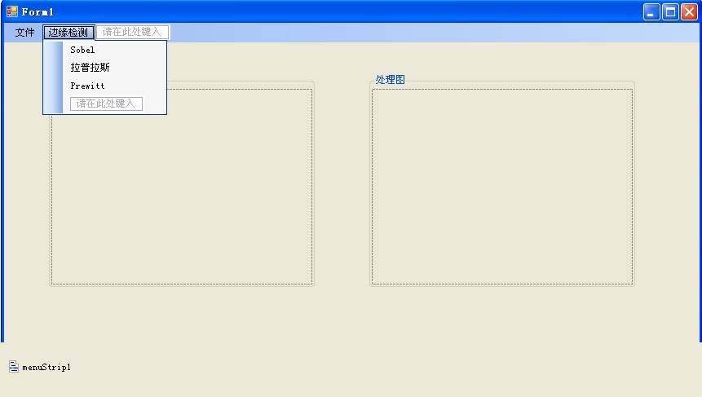
“边缘检测”及子菜单如下：

Slide 15
分别将SobelA(), display_image(), TemplateA()函数加入Form1或自定义头文件中：
void Sobel(double **tenA,double **tenB,int tenNo,int nWidth, int nHeight,BYTE **formerImage,BYTE **imageT)
{
double **imageT1;
double **imageT2;
double sum = 0;
imageT1 = new double *[nHeight];
imageT2 = new double *[nHeight];
for(int i=0;i<nHeight;i++)
{
imageT1[i]=new double[nWidth];
imageT2[i]=new double[nWidth];
}

Slide 16
Template(tenA,tenNo,nWidth,nHeight,formerImage,imageT1);
Template(tenB,tenNo,nWidth,nHeight,formerImage,imageT2);
for( int i=0; i<nHeight; i++ )
{
for( int j=0; j<nWidth; j++)
{
sum= Math::Pow(imageT1[i][j]*imageT1[i][j] +imageT2[i][j]*imageT2[i][j],1); if(sum>255) sum=255;
if(sum<0) sum=0;
imageT[i][j] = (BYTE)sum;
}
}

Slide 17
for( int i=0; i<nHeight; i++ )
{
delete []imageT1[i];
delete []imageT2[i];
}
delete []imageT1;
delete []imageT2;

Slide 18
void display_image(Bitmap^ bmap,int **grey)
{
for(int i=0;i<nHeight;i++)
{
for(int j=0;j<nWidth;j++)
{
bmap-> SetPixel (j,i,Color::FromArgb(grey[i][j],grey[i][j],grey[i][j]));
}
}
}

Slide 19
void Template(double **ten,int tenNo,int nWidth, int nHeight,
BYTE **formerImage,double **imageT)
{
//模板四个方向上的宽度变量
int No=tenNo/2;
//模板四个方向和原图形的重叠量
int front=0;
int back=0;
int left=0;
int right=0;
double sum=0;

Slide 20
for(int i=0;i<nHeight;i++)
{
for(int j=0;j<nWidth;j++)
{
//求模板四个方向和原图形的重叠量
if(i<No) front=i;
else front=No;
if(nHeight-i-1<No) back=nHeight-i-1;
else back=No;
if(j<No) right=j;
else right=No;
if(nWidth-j-1<No) left=nWidth-j-1;
else left=No;
sum=0;

Slide 21
//求取当前点区域和模板卷积的结果
for(int h=-front;h<=back;h++)
{
for(int k=-right;k<=left;k++)
{
sum+=ten[h+No][k+No]*((double)formerImage[i+h][j+k]);
}
}
//存储处理结果
imageT[i][j]=sum;
}
}
}

Slide 22
双击“Sobel”,添加如下代码
double ten11[3][3] = {{-1.0/8.0,-2.0/8.0,-1.0/8.0},{0,0,0},{1.0/8.0,2.0/8.0,1.0/8.0}};
double ten22[3][3] = {{-1.0/8.0,0,1.0/8.0},{-2.0/8.0,0,2.0/8.0},{-1.0/8.0,0,1.0/8.0}};
double **ten1;
double **ten2;
int tenNo = 3;
ten1 = new double *[tenNo];
ten2 = new double *[tenNo];
for( int i=0; i<tenNo; i++ )
{
ten1[i] = new double [tenNo];
ten2[i] = new double [tenNo];
}
for( int i=0; i<tenNo; i++ )
{

Slide 23
for( int j=0; j<tenNo; j++ )
{
ten1[i][j] = ten11[i][j];
ten2[i][j] = ten22[i][j];
}
}
Sobel(ten1, ten2, tenNo, nWidth, nHeight, oriImage, proImage);
for( int i=0; i<tenNo; i++)
{
delete []ten1[i];
delete []ten2[i];
}

Slide 24
delete []ten1;
delete []ten2;
display_image( processed_bmap, proImage );
pictureBox2->Refresh();

Slide 25
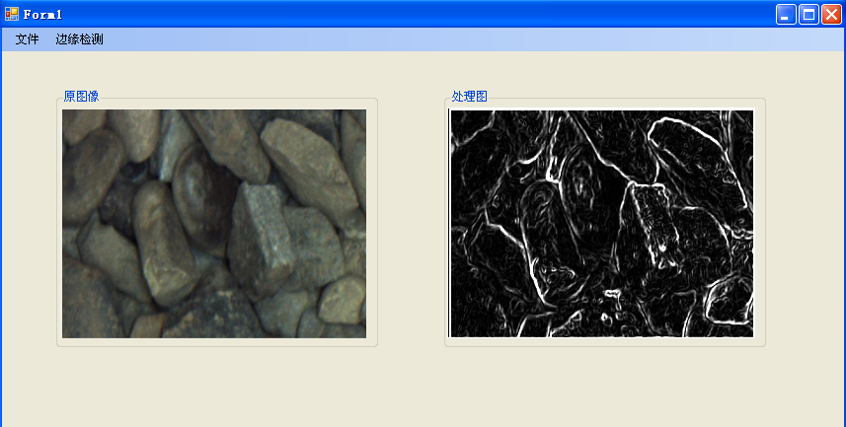
Sobel结果如图:

Slide 26
“拉普拉斯”,“ Prewitt”仿照Sobel即可，自己完成。

Slide 27


